Slide 1

Vel Tech Rangarajan Dr. Sagunthala R&D Institute of Science and Technology
School of Computing
Department of Computer Science and Engineering
10211CS224 / FULL STACK APPLICATION DEVELOPMENT (JAVA)
PROJECT REVIEW : MILESTONE PROJECT – 1
Date: 02-02-2026
Dynamic Online Examination & Result Processing System
SDG: SDG 4 – Quality Education
Presented By:
A.Naga Vinay Gopi – VTU25557 – 23UECS0648
Courses Handling Faculty:
Dr. S . HEMAMALINI – M.E., Ph.D.,

Slide 2
INTRODUCTION
1
Background of the problem:
Manual exams are time-consuming, error-prone, and delay result processing, creating a need for an automated online examination system.
Why this project is important:
To reduce evaluation errors, save time, and provide instant results for students and teachers.
Real-world relevance:
Used in schools, colleges, competitive exams, and online learning platforms to streamline assessments efficiently.
Brief overview of the system:
A dynamic web-based system where students can register, take exams, and view results instantly, with data stored securely in a database.
2
3
4
5
6
7
8
9

Slide 3
PROBLEM STATEMENT
In many educational institutions and training platforms, quizzes are conducted manually or using basic systems that lack automation. This creates difficulties in managing users, organizing quizzes, evaluating answers, and generating results efficiently. Manual evaluation consumes time and may lead to calculation errors. Generating certificates separately also increases administrative workload. There is a need for a secure, reliable, and fully automated quiz system that can manage users, conduct quizzes, calculate scores instantly, and generate certificates automatically. Such a system improves accuracy, saves time, and enhances overall performance.
1
2
3
4
5
6
7
8
9

Slide 4
OBJECTIVES
1.To develop a dynamic online examination system that replaces manual evaluation.
2.To allow students to register, login, and take exams online securely.
3.To store questions and results in a database for easy management and retrieval.
4.To calculate scores and percentages automatically immediately after the exam.
5.To support multiple subjects and multiple sets of questions for different exams.
6.To provide a user-friendly and responsive interface for students.
1
2
3
4
5
6
7
8
9

Slide 5
PROPOSED SYSTEM
1
1.A web-based dynamic online examination system using HTML, CSS, JavaScript (ES6), Node.js, and MySQL.
2.Allows students to register, login, select subjects, take exams, and view results instantly.
3.Stores all questions, subjects, students, and results securely in a MySQL database.
4.Calculates scores and percentages automatically immediately after exam submission.
5.Provides a secure session-based authentication system to prevent unauthorized access.
6.Supports multiple subjects and generates random question sets for each individual exam.
7.User interface is responsive and centered, providing a clear and accessible display of questions and results.
2
3
4
5
6
7
8
9

Slide 6
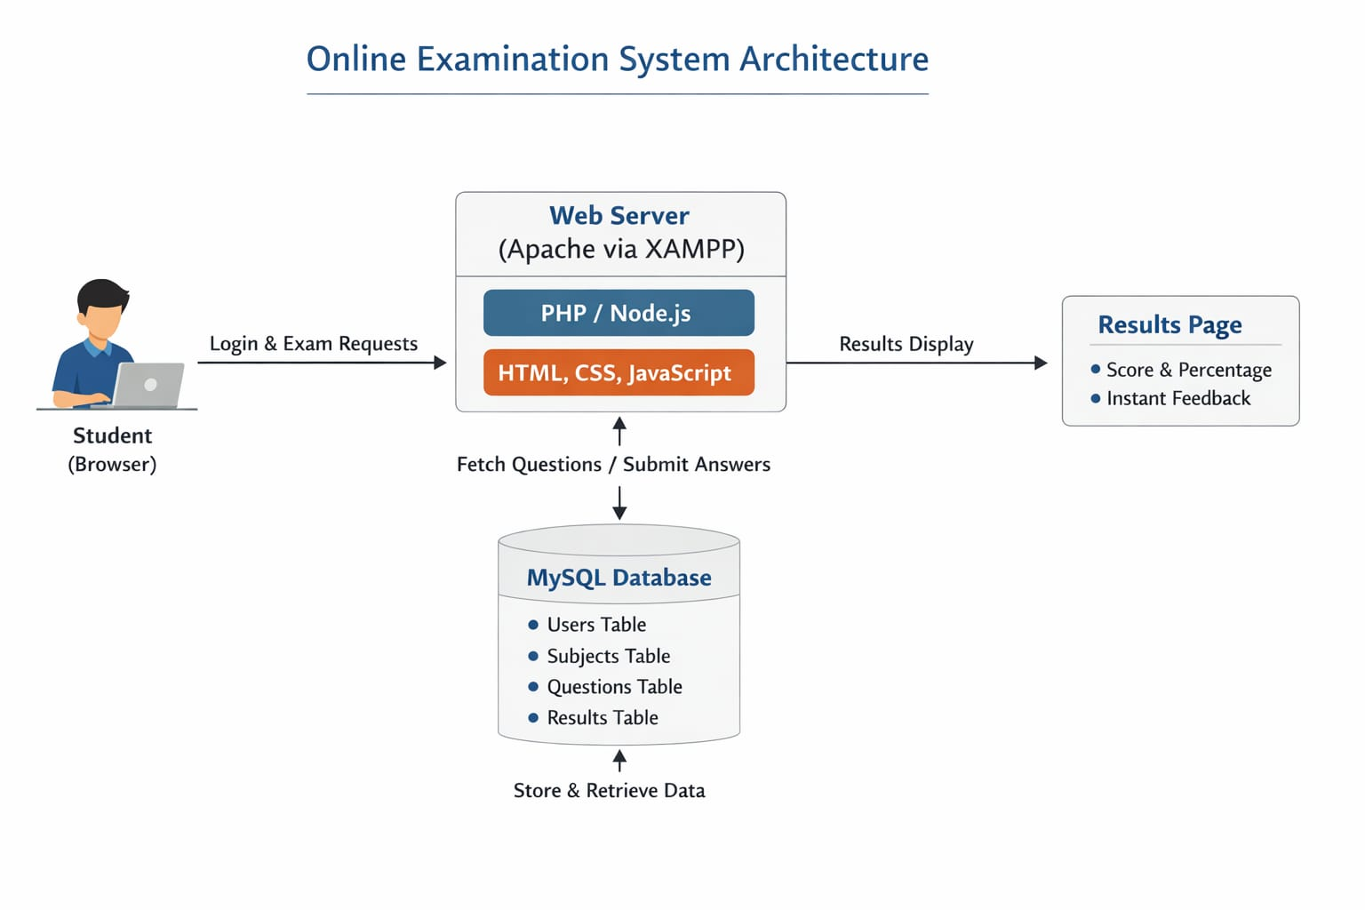
PROPOSED SYSTEM ARCHITECTURE
1
2
3
4
5
6
7
8
9

Slide 7
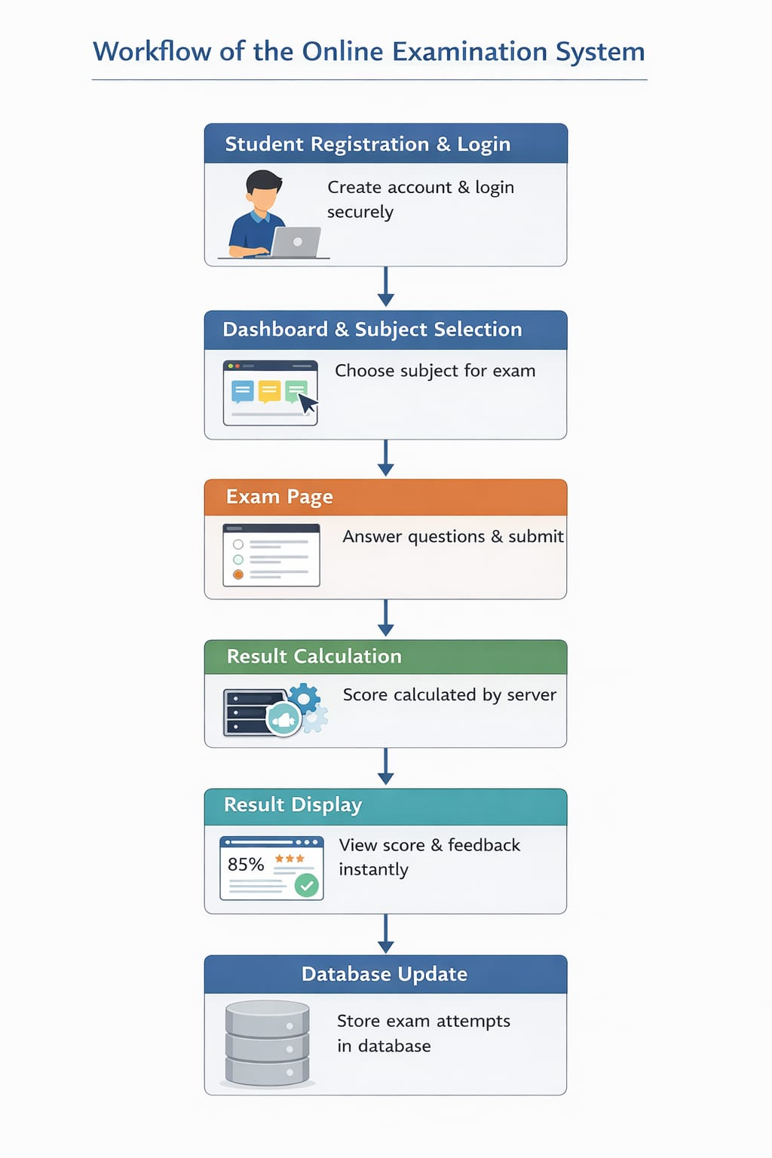
WORKFLOW
1
2
3
4
5
6
7
8
9

Slide 8
TECHNOLOGIES USED
1
Front-End:
HTML5 & CSS3 ➔ For designing the web pages and styling.
JavaScript (ES6) ➔ For interactive features like question navigation and form validations.
Back-End:
Node.js & Express.js ➔ Handles server-side logic, authentication, exam processing, and result calculation.
Database:
MySQL ➔ Stores users, subjects, questions, and exam results.
Server / Environment:
Node.js Runtime ➔ Local server environment to run JavaScript on the backend.
local MySQL Server ➔ To manage and host the database.
Development Tools:
VS Code ➔ Editor for writing HTML, CSS, JS, and Node.js backend code.
Browser (Chrome/Edge/Firefox) ➔ To access and test the application
2
3
4
5
6
7
8
9

Slide 9
MODULE DESCRIPTION
1.User Registration & Login
-Students can register with their details and login securely using sessions.
-Passwords are stored using encryption (hashed) for security.
2.Dashboard
-After login, students see a list of subjects available for exams.
-Navigation to exams and results is provided.
3.Exam Module
-Students select a subject and take the exam.
-Questions are fetched dynamically from the database.
-Answers are submitted and stored for evaluation.
4.Result Module
-Server calculates score and percentage automatically.
-Results are displayed instantly and stored in the results table.
5.Database Module
-Manages users, subjects, questions, and results.
-Ensures data integrity and supports multiple subjects and exams.
1
2
3
4
5
6
7
8
9

Slide 10

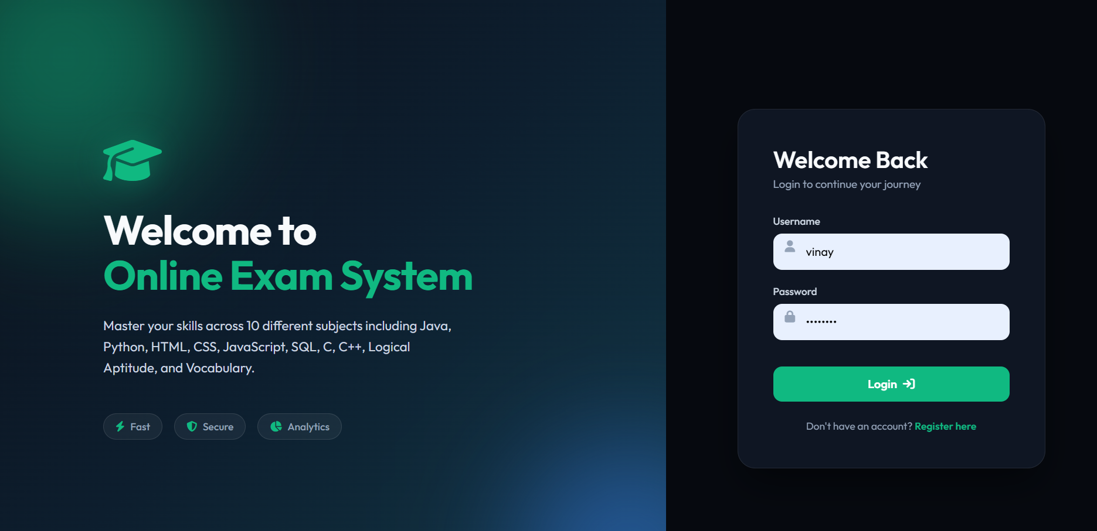
IMPLEMENTATION SCREENSHOTS
Registration & Login page:
1
2
3
4
5
6
7
8
9

Slide 11
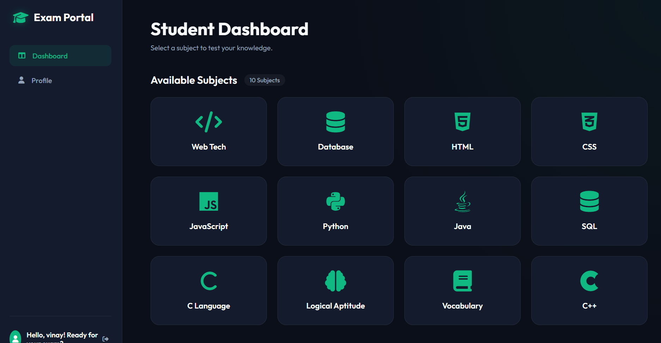
IMPLEMENTATION SCREENSHOTS
DashBoard :
1
2
3
4
5
6
7
8(A)
9

Slide 12
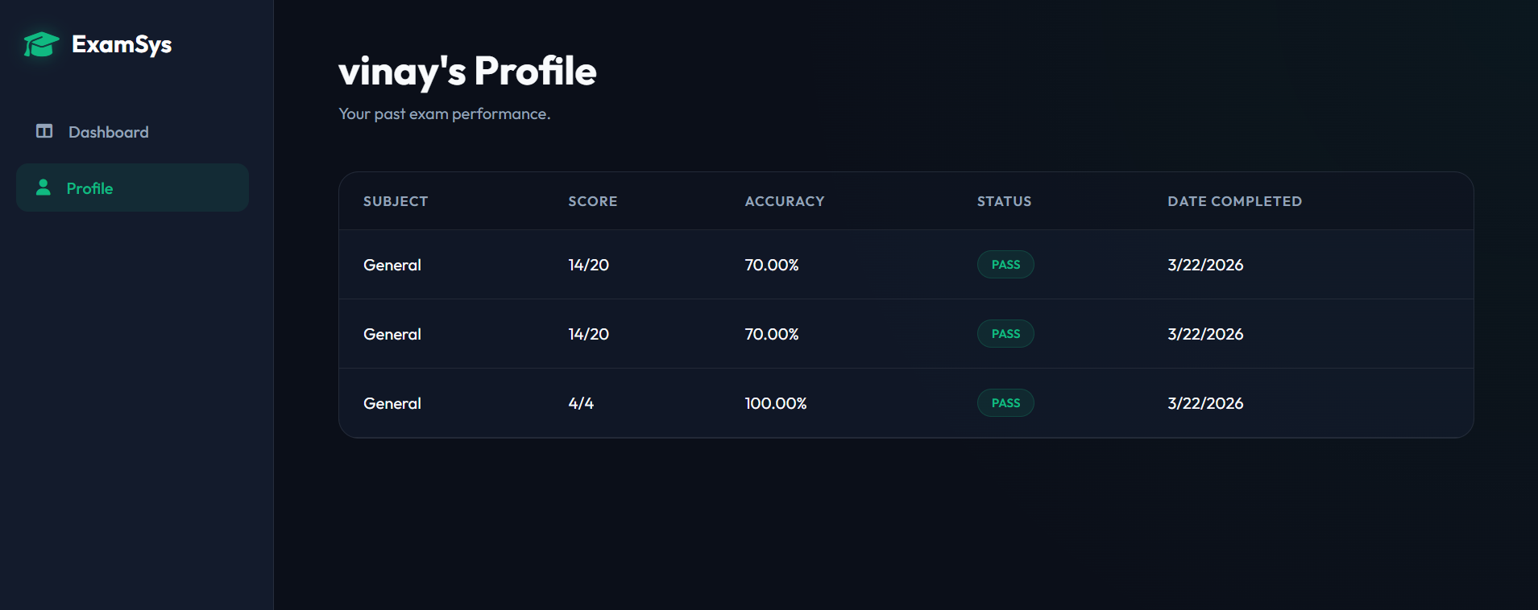
IMPLEMENTATION SCREENSHOTS
Result page:
1
2
3
4
5
6
7
8(B)
9

Slide 13
ADVANTAGES & LIMITATIONS
Advantages:
-Automated Evaluation: Instant scoring and result calculation, saving manual effort.
-Randomized Questions: Each student gets a unique, randomized question set to prevent cheating.
-Role-Based Access: Separate dashboards and functionalities for students and admins.
-Subject Flexibility: Supports dynamic exams categorized across multiple subjects.
-Real-Time Leaderboard: Tracks and ranks top students to encourage healthy competition.
Limitations:
-No Proctoring Features: Lacks browser lockdown or webcam monitoring during exams.
-Limited Question Types: Currently only supports multiple-choice questions (MCQs).
-No Auto-Save: Exam progress might be lost if the internet disconnects or browser crashes before submission.
-Basic Security: Passwords and sensitive data could use advanced encryption (like hashing) for better security.
-Database Scalability: Randomizing questions becomes slower as the database size grows significantly.
1
2
3
4
5
6
7
8
9

Slide 14
Thank you

